Slide 1

Gears ‘n stuff: Angular Velocity
How fast something rotates is called Angular Velocity (ω). Units of angular velocity include revolutions per minute (RPM) and radians per second.
In this box, if the little gear has 8 teeth and the big gear has 24, how many revolutions will the big gear make for each revolution of the little one?
If both motors turn at the
same rate, which gear turns
faster (with higher angular velocity), A or B?
If gear 1 is mated with gear 2, then N₁ω₁ = N₂ω₂
A
B

Slide 2
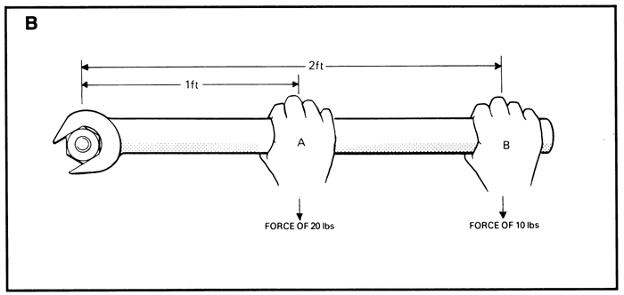
Gears ‘n stuff: Torque
A twisting force, or a force applied on a lever arm, is called torque (τ).
Units of torque include foot
pounds, newton meters, etc.
Which would have more torque, A or B? (hint: think about a bicycle…)
If gear 1 is mated with gear 2, then τ ₁ω₁ = τ ₂ω₂
You can use gears to trade torque for angular velocity. This is really useful.
A
B

Slide 3
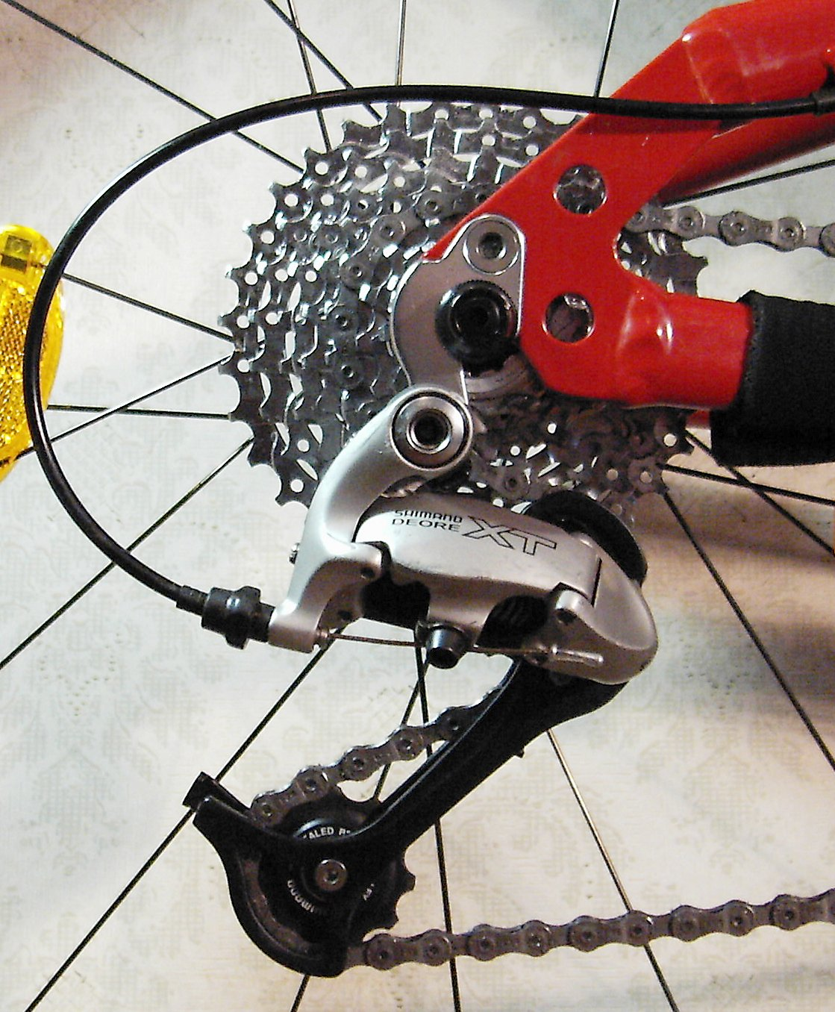
Gears ‘n stuff: Using gears
The motor has some maximum power output – (for NXT, it's basically the rate at which it can drain the battery.) You can use that for high torque with low angular velocity, or high angular velocity with low torque.
The transmission of a bike or car lets you switch back and forth -- “low gear” for power, “high gear” for speed.
Notes:
talk about lever, opening a door – easier to push at outside edge but it opens more slowly. . .

Slide 4

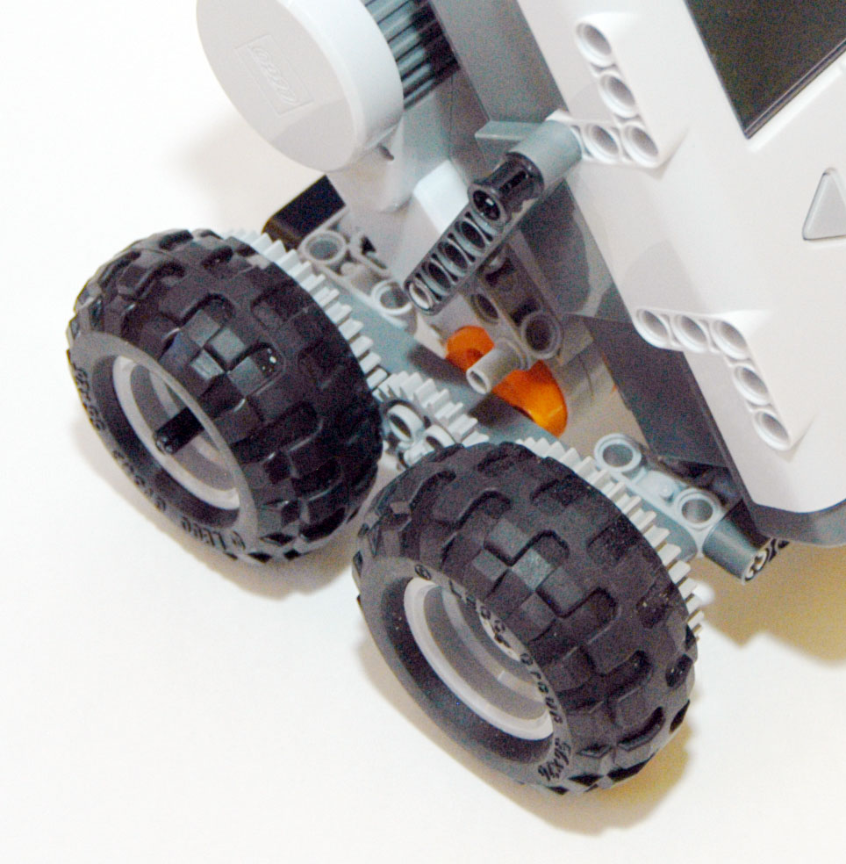
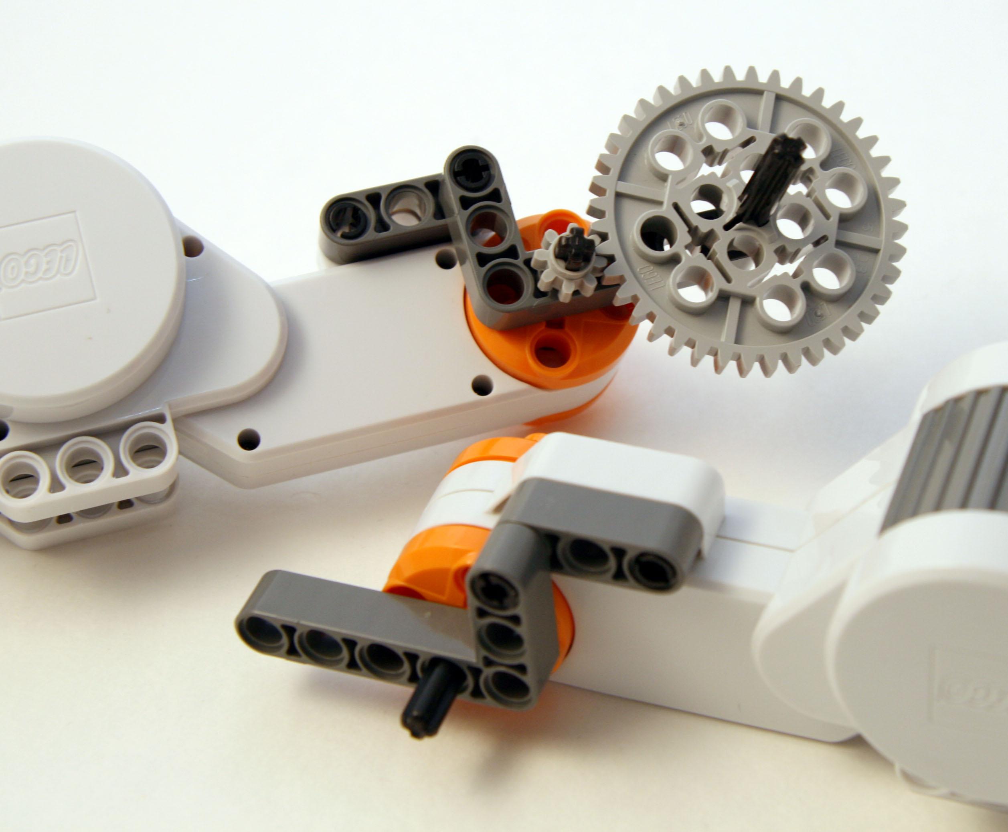
Using NXT Gears

